Slide 1
Retro Paradise
an app for the games of the past
Darin McDonald
Jacob White
Lawrence Murillo

Slide 2
What is retro paradise?
Retro Paradise is store that buys and sells old video game consoles and games at a fair price all at the click of a button on your smartphone.
Have you ever thought “Wow, I would really like to get this game I played when I was younger?” well we got you covered.
This app is designed to cater towards retro game fans to help bring back rare/hard to find group of video games.

Slide 3
How do I use it?
To use the app for our store you will have to register an account. It’s simple! After providing the information your account will be created and you can login and start shopping.

Slide 4
Okay I’m signed in… now what?
Now that you’ve signed in you can search for anything you want. You can check new additions to the store as well as what’s coming.

Slide 5
Still need help with the app?
There’s a user manual for anyone that needs further assistance with using and navigating our app!

Slide 6
So now what?
With additional time and effort we will grow this app from it is now to something much greater. Updates, more functionality, and of course anything else we can do to make sure this app grows to be a paradise for the games of old.

Slide 7
Thank you!

Slide 8


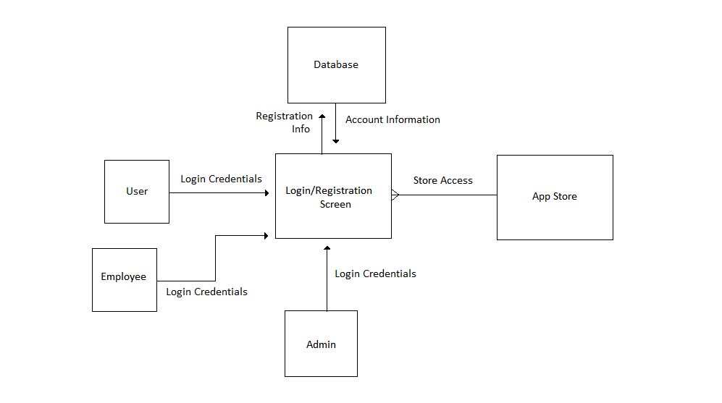
Context diagram

Slide 9
User manual
How to use:
To use the Retro Paradise Store Application you must login in by providing your User Name and Password at the login in screen.
If you are a new user, however, you will need to register by choosing “Register Account” instead of choosing to login.
(Alternatively you can choose to skip sign in if you would like to browse without using an account and sign in later)
After successfully signing in to the app you can choose from the many different options below
1. Browse
2. Your Orders
3. Recommendations/Favorites
4. Cart
5. Settings
6. Customer Service
7. Account Access
Please refer to each section for further information.
Browsing consist of knowing what platform you are looking for, after that knowing what kind of accessory you need for that platform.
Once you have decided what you want, you can place your order, which will appear in the cart and then we will require your name, address, credit card information.
If need to change anything pertaining to the app, i.e. what kind of games are suggested to you while you browse, you can go to the settings portion of the app.
We also have customer service so If there is something you don’t understand or need help with, we are here to help you.
You can also access your account through the app, just incase you need to change or update something.

